Slide 1

AMAZON SALES ANALYSIS
DONE BY :
P L NANCY

Slide 2
PROBLEM STATEMENT
Sales management has gained importance to meet increasing competition and the need for improved methods of distribution to reduce cost and to increase profits. Sales management today is the most important function in a commercial and business enterprise.
Do ETL: Extract-Transform-Load some Amazon dataset and find for Sales-trend -> month-wise, year-wise, yearly_month-wise.
Find key metrics and factors and show the meaningful relationships between attributes.

Slide 3
SALES TRENDS & KEY METRICS
SALES TRENDS USED :
Month-wise sales trend
Year-wise sales trend
Yearly_Month-wise sales trend
KEY METRICS and RELATION ATTRIBUTES USED :
Sales by Regions
Total Sales by each Region over the years
Profits by Country
Top 10 countries making highest sales and profit
Sales by Items
Items in the regions with profits
Sales Channel Effectiveness
Total Sales, Total Profit and Average Order Processing time for each items and sales channel

Slide 4
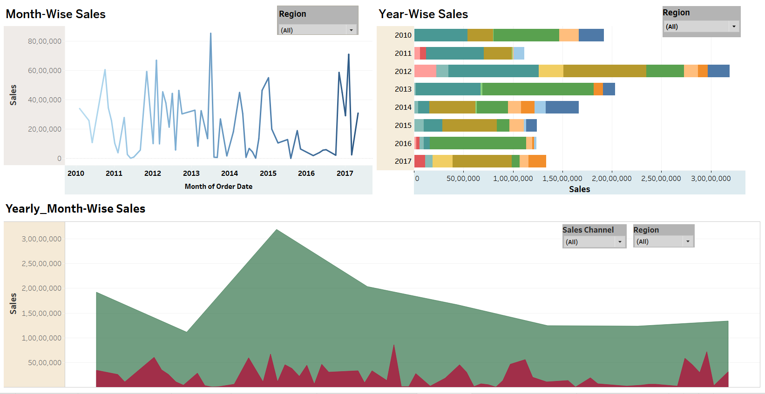
SALES TREND VISUALS

Slide 5
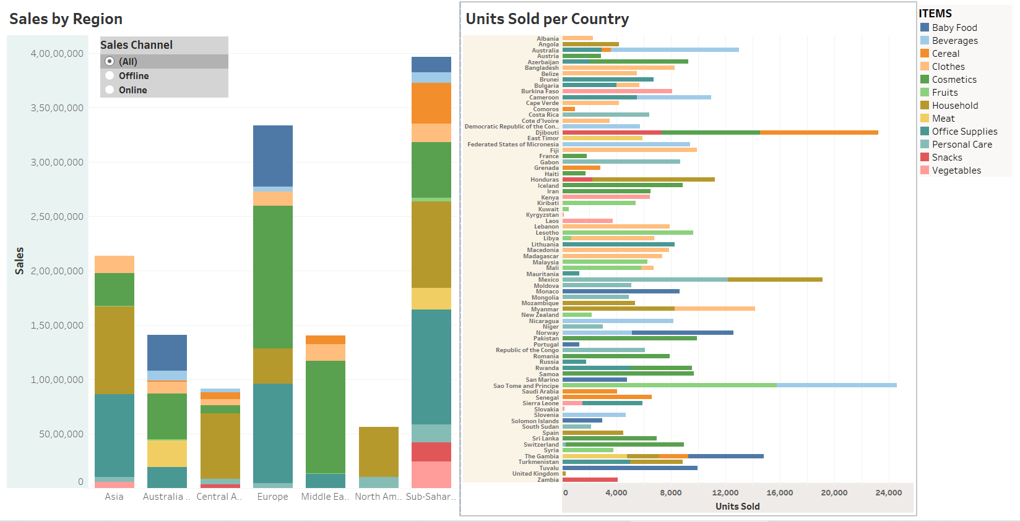
KEY METRICS & ATTRIBUTES VISUALS

Slide 6
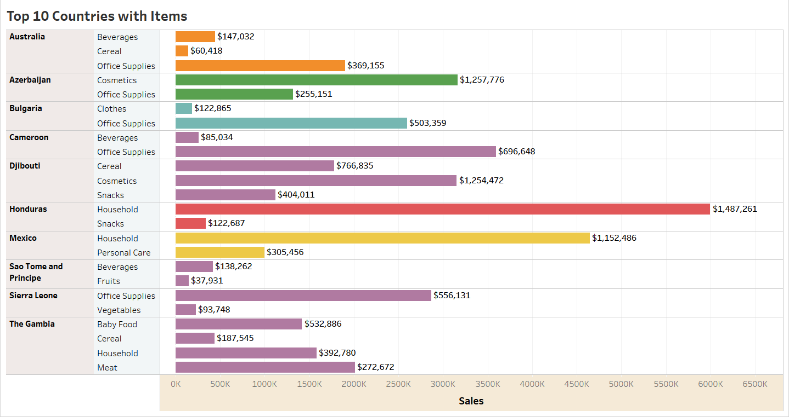

Slide 7
INSIGHTS FOR SALES TREND
1. Month-wise Sales Trend:
Peaks in sales during the 2nd and 11th months indicate seasonal patterns or specific events driving higher consumer demand during those periods.
Conversely, the 3rd and 8th months show lower performance, suggesting potential challenges or reduced consumer interest during those times.
2. Year-wise Sales Trend:
The data illustrates fluctuating sales performance across consecutive years, with 2012 standing out as the year with the highest sales.
A slight decrease in sales is observed in 2013, indicating a potential shift in market dynamics or economic conditions impacting consumer spending.
3. Yearly_Month-wise Sales Trend:
There is a upward trend in sales from 2010 to 2015, indicating market growth and sustained consumer demand during this period.
The years 2016 and 2017 present a mixed picture, with fluctuations in sales across different months and potentially stagnant or declining sales in some periods.

Slide 8
INSIGHTS FOR KEY-METRICS
Regional Sales Performance: Sub-Saharan Africa emerges as a consistent contributor to total sales, showcasing resilience and importance in the overall landscape. Europe demonstrates recovery and stability after a temporary setback, while Asia shows steady growth. In contrast, North America lags behind, indicating potential challenges or limited market presence.
Country-specific Profitability: Djibouti stands out as the top performer in profitability, indicating strong revenue generation or efficient cost management. Conversely, Kuwait records the lowest profits, highlighting potential challenges in revenue generation or profitability.
Items Category Insights: Cosmetics emerge as consistent top performers, indicating universal demand. Essential items like Household and Office Supplies also demonstrate strong sales performance. However, certain categories like Fruits face challenges in consumer adoption or market penetration.
Offline vs. Online Channels: Despite higher sales in offline channels, the efficiency of order processing varies across product categories. While some categories like Cosmetics and Baby Food thrive in both channels, others like Meat and Snacks struggle, hinting at potential demand issues.

Slide 9
CONCLUSION
Strategies can be done to capitalize on peak months by adjusting marketing efforts, promotions, or product launches to align with consumer preferences and maximize sales. Similarly, addressing issues during low-sales months may involve targeted promotions or incentives to stimulate demand.
Analyzing year-wise trends helps identify long-term growth patterns and factors influencing sales performance, enabling strategic planning and adjustments to maintain or improve sales levels over time.
Make strategies for each region based on its performance. Invest more resources in Sub-Saharan Africa and emerging markets in Asia while addressing challenges in North America.
Emphasize efficient cost management practices, as seen in Djibouti, to improve profitability across all countries.
Diversify revenue streams to mitigate risks and sustain growth, considering the diverse patterns observed in sales and profits.
Invest in promoting top-selling items like Cosmetics, Office Supplies, and Household items while addressing challenges in categories like Fruits through targeted marketing and product innovation.
Balance offline and online sales channels based on customer preferences and optimize processing times to enhance sales and profits across all product categories.
Continuously monitor market trends, consumer preferences, and competitor strategies to adapt and refine sales and profit optimization strategies accordingly.

Slide 10
THANK
YOU

